Slide 1
SEASONAL DECOMPOSITION
Renato R. Maaliw III, DIT
College of Engineering
Southern Luzon State University
Lucban, Quezon, Philippines

Slide 2


Slide 3


Slide 4
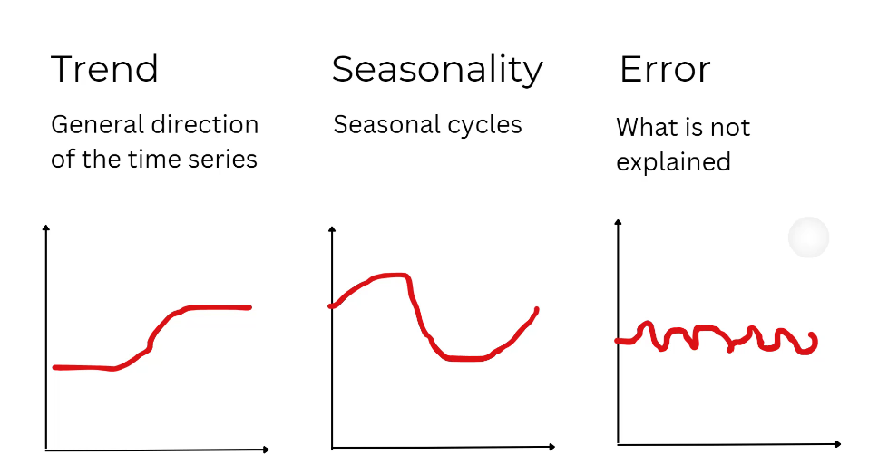

Slide 5
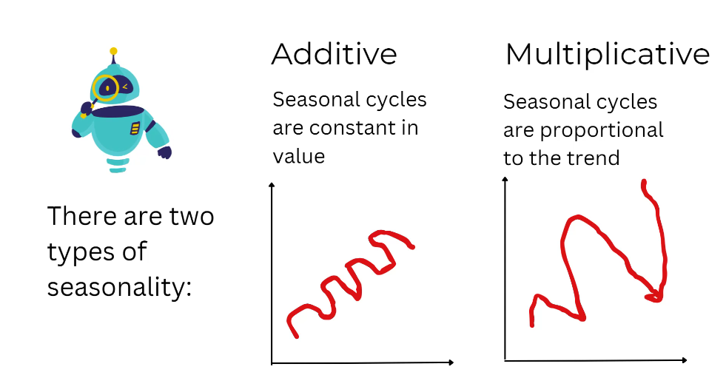

Slide 6


Slide 7


Slide 8
[CODE DEMO]

Slide 9
01. What is the main purpose of applying a seasonal decomposition to a time series before modeling?
A. To reduce the dimensionality of the dataset for principal component analysis
B. To separate the series into trend, seasonal, and residual components
C. To remove autocorrelation completely
D. To convert non-stationary data into strictly white noise

Slide 10
01. What is the main purpose of applying a seasonal decomposition to a time series before modeling?
A. To reduce the dimensionality of the dataset for principal component analysis
B. To separate the series into trend, seasonal, and residual components
C. To remove autocorrelation completely
D. To convert non-stationary data into strictly white noise

Slide 11
02. When deciding between an additive versus a multiplicative seasonal model, which rule of thumb is most appropriate?
A. Always use multiplicative when data are in percentages
B. Use additive if the seasonal pattern length is <= 12 periods
C. Choose additive if the amplitude of seasonal swings stays roughly constant over time
D. Pick the form that gives a higher R-squared in a linear regressions

Slide 12
02. When deciding between an additive versus a multiplicative seasonal model, which rule of thumb is most appropriate?
A. Always use multiplicative when data are in percentages
B. Use additive if the seasonal pattern length is <= 12 periods
C. Choose additive if the amplitude of seasonal swings stays roughly constant over time
D. Pick the form that gives a higher R-squared in a linear regressions

Slide 13
Thank you very much for listening.

